Slide 1

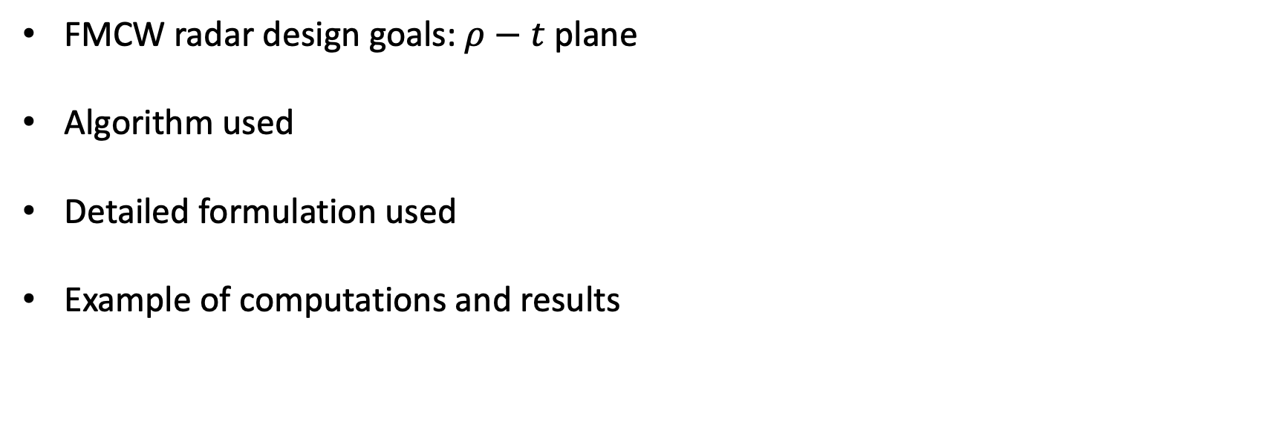
Contents
FMCW radar design goals: $ρ−t$ plane
Algorithm used
Detailed formulation used
Example of computations and results

Slide 2
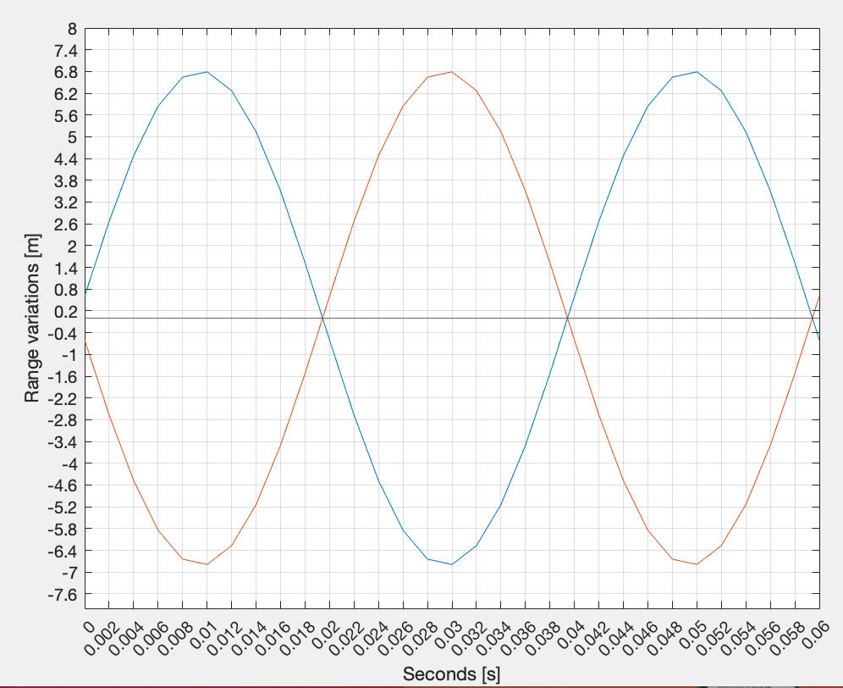
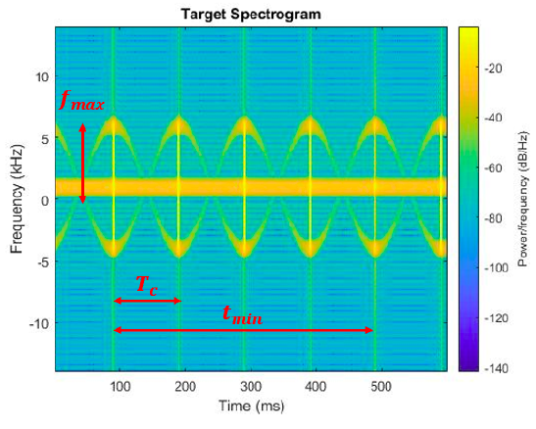



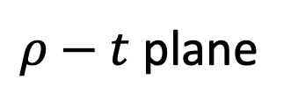

Radar design goals
$ρ−t$ plane
$f−t$plane
$$ρ_{migr}$$
$$T_{migr}$$
$$t_{dwell_min}$$

Slide 3

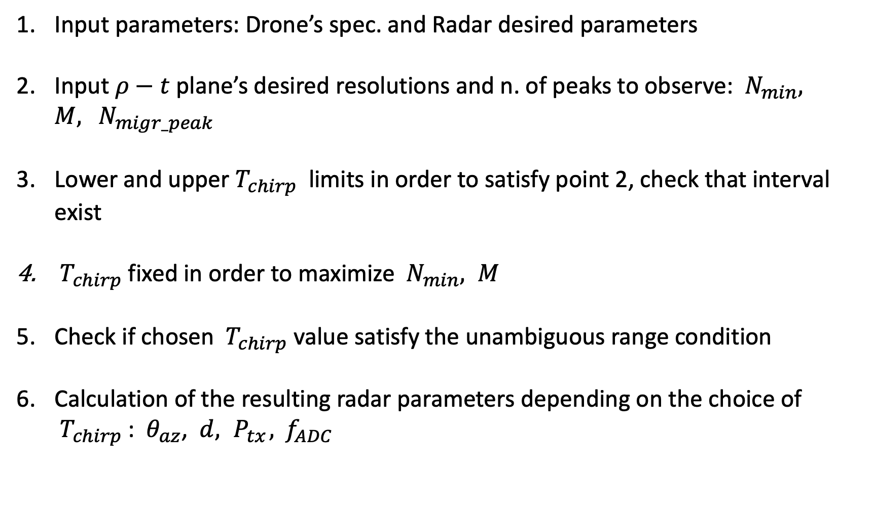
Algorithm: $ρ−t$ plane
Input parameters: Drone’s spec. and Radar desired parameters
Input $ρ−t$ plane’s desired resolutions and n. of peaks to observe: ${ N}_{min}, M, { N}_{migr_peak}$
Lower and upper $T_{chirp}$limits in order to satisfy point 2, check that interval exist
${ T}_{chirp}$ fixed in order to maximize ${ N}_{min}, M$
Check if chosen ${ T}_{chirp}$ value satisfy the unambiguous range condition
Calculation of the resulting radar parameters depending on the choice of ${ T}_{chirp}$ : $θ_{az}$, $d, { P}_{tx}, { f}_{ADC}$

Slide 4

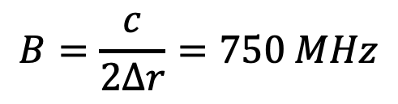
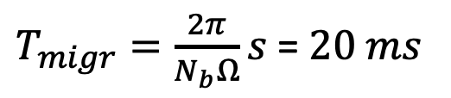














Algorithm: calculation example helic. drone
1.Input drone’s parameters
1.Input radar parameters
$$Ω=25∗2π rad/s$$
$$f=9 GHz$$
$$ρ=0.6 m$$
$$λ=0.0333 m$$
$v_{tip}=Ωρ$ $=$ $94.25 m/s$
$$∆r=0.2 m$$
$$N_{r}=1$$
$$B=\frac{c}{2∆r}=750 MHz$$
$$N_{b}=2$$
$t_{scan}=2 s$
$T_{migr}=\frac{2π}{N_{b}Ω}s$ = $20 ms$
$$SNR=20 dB$$
$$R_{0}=0 m^{2}$$
$$θ_{el}=60°$$
$$σ=0.01 m$$
$$T_{s}=290 K$$
$$L=10 dB$$

Slide 5
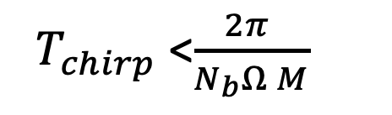
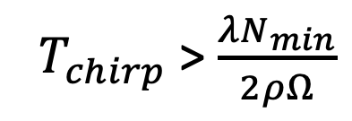


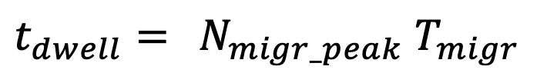
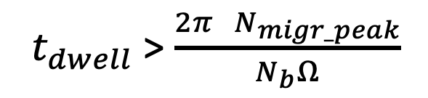
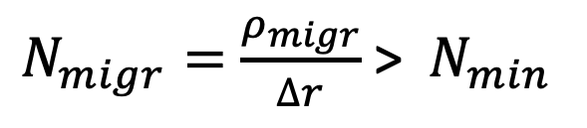


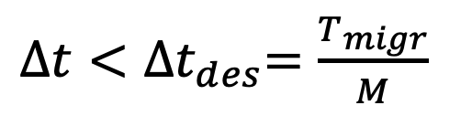

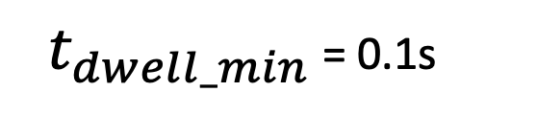
Algorithm: calculation example helic. drone
2. Input $ρ−t$ plane’s data: desired ${ N}_{min}, M, { N}_{migr_peak}$
$N_{migr}=$ $\frac{ρ_{migr}}{∆r}$ > ${ N}_{min}$
${ T}_{chirp}$ > $\frac{λN_{min}}{2ρΩ}$
${ T}_{chirp_min}$
${∆t<∆t}_{des}=\frac{T_{migr}}{M}$
${ T}_{chirp}$ <$\frac{2π }{N_{b}Ω M}$
${ T}_{chirp_max}$
$t_{dwell}={ N}_{migr_peak}$ $T_{migr}$
${ t}_{dwell}$ > $\frac{2π{ N}_{migr_peak}}{N_{b}Ω}$
${ t}_{dwell_min}$
3. Start with ${ N}_{min}=1, M=1, { N}_{migr_peak}$ = 5
${ t}_{dwell_min}$ = 0.1s
${ T}_{chirp_min}=0.176 ms$
${ T}_{chirp_max}=20 ms$

Slide 6

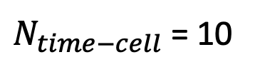





Algorithm: calculation example helic. drone
4. Fix ${ T}_{chirp}$ in order to maximize ${ N}_{min}, M$
- ‘While’ cycle that increase ${ N}_{min}, M$ by 1 each time
- Re compute ${ T}_{chirp_max}$ and ${ T}_{chirp_min}$
- If ${ T}_{chirp_max}$ and ${ T}_{chirp_min}$ are not compatible then stop the cycle
At the end of cycle we have:
${ N}_{min}=10, M=10$
${ T}_{chirp_min}=1.8 ms$
${ T}_{chirp_max}=2 ms$
By selecting ${ T}_{chirp}={ T}_{chirp_max}$ $= 2 ms$:
$$N_{migr}=11$$
and
$N_{time−cell}$ = 10

Slide 7


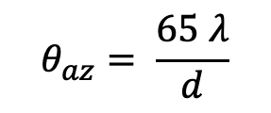


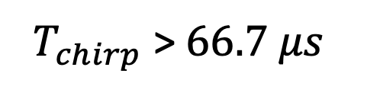
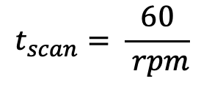
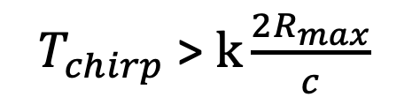
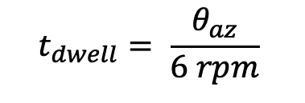

Algorithm: calculation example helic. drone
5. Check if ${ T}_{chirp}$ satisfy unambiguous range condition:
${ T}_{chirp}$ > $k\frac{2R_{max}}{c}$
K > 10
${ T}_{chirp}$ > $66.7 μs$
With
6. Resulting $θ_{az}$, $d :$
$$t_{scan}= \frac{60}{ rpm}$$
$$rpm=30$$
$$t_{dwell}= \frac{θ_{az}}{6 rpm}$$
$$θ_{az}=t_{dwell_min} ∗6 rpm=18°$$
$$θ_{az}= \frac{65 λ}{d}$$
$$d=0.12 cm$$

Slide 8
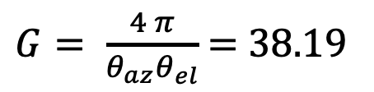


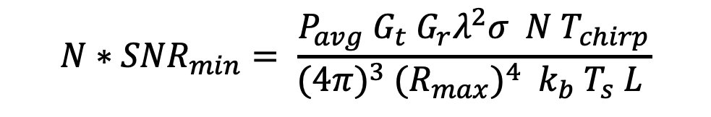
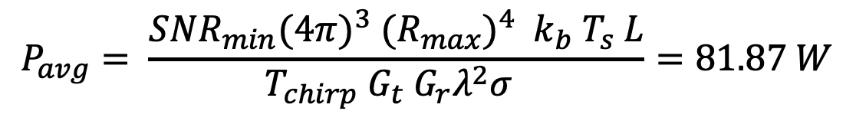
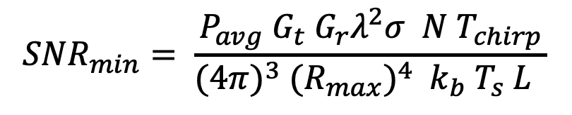
Algorithm: calculation example helic. drone
6. Resulting ${ P}_{avg}$:
[Texas instruments formula]
$${SNR}_{min}= \frac{P_{avg}{ G}_{t}{ G}_{r}λ^{2}σ N T_{chirp}}{{(4π)}^{3} {{(R}_{max})}^{4} { k}_{b} T_{s} L }$$
$${N∗SNR}_{min}= \frac{P_{avg}{ G}_{t}{ G}_{r}λ^{2}σ N T_{chirp}}{{(4π)}^{3} {{(R}_{max})}^{4} { k}_{b} T_{s} L }$$
$${SNR}_{min}=20 dB,$$
$$P_{avg}= \frac{{SNR}_{min}{(4π)}^{3} {{(R}_{max})}^{4} { k}_{b} T_{s} L}{{T_{chirp} G}_{t}{ G}_{r}λ^{2}σ }=81.87 W$$
$G= \frac{4 π}{θ_{az}θ_{el}}$ $=$ $38.19$

Slide 9
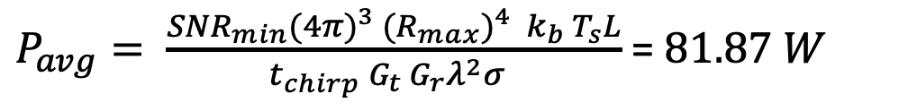

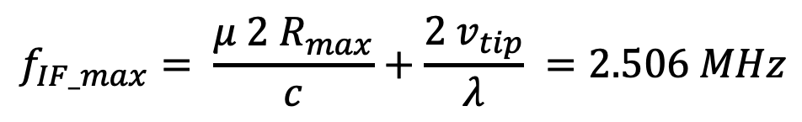

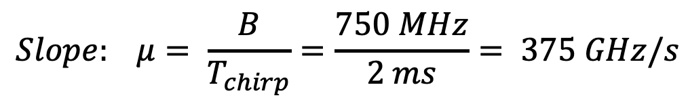
Algorithm: calculation example helic. drone
6. Resulting ${ P}_{avg}$:
$P_{avg}= \frac{{SNR}_{min}{(4π)}^{3} {{(R}_{max})}^{4} { k}_{b} T_{s}L}{{t_{chirp} G}_{t}{ G}_{r}λ^{2}σ }$ = $81.87 W$
6. Resulting ${ f}_{ADC}, Slope$ :
$$Slope: μ= \frac{B}{T_{chirp}}=\frac{750 MHz}{2 ms}= 375 GHz/s$$
Graphic result in the next slide
$$f_{IF_max}= \frac{μ 2 R_{max}}{c}+\frac{2 v_{tip}}{λ} =2.506 MHz$$
$$f_{ADC}=2f_{IF_max} =5.0113 MHz$$

Slide 10
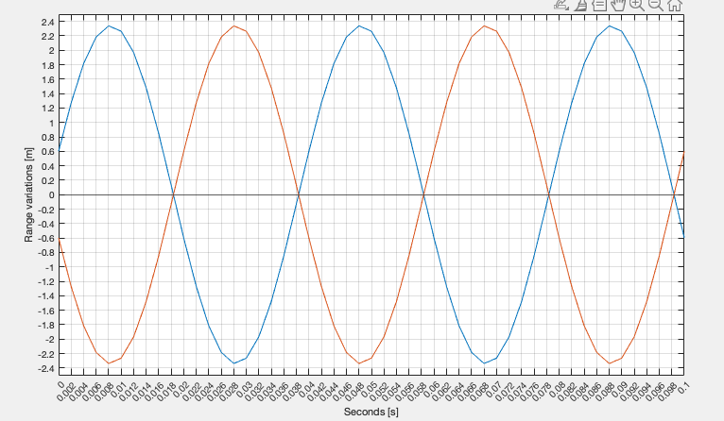





Algorithm: calculation example helic. drone
$$∆r$$
${ N}_{migr}$ = 11
${ N}_{time_cell}$ = 10
${ N}_{migr_peak}$ = 5
$$∆t={ T}_{chirp}$$

Slide 11
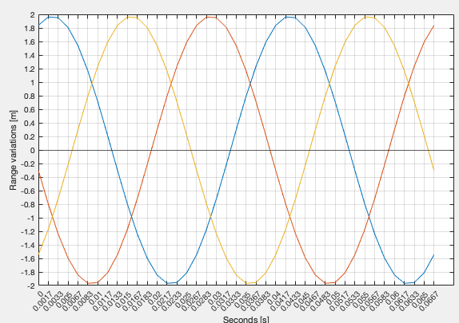



Algorithm: calculation example helic. drone
${ N}_{migr}$ = 10
Case N_b = 3
${ N}_{time_cell}$ = 8
${ N}_{migr_peak}$ = 5

Slide 12

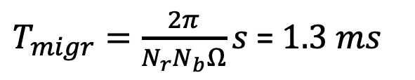




Algorithm: calculation example quad. drone
1.Input drone’s parameters
1.Input radar parameters
$$Ω=100∗2π rad/s$$
$$f=9 GHz$$
$$ρ=0.1 m$$
$$λ=0.0333 m$$
$v_{tip}=Ωρ$ $=$ $62.83 m/s$
$$∆r=0.2 m$$
$$N_{r}=4$$
$$B=\frac{c}{2∆r}=750 MHz$$
$$N_{b}=2$$
$t_{scan}=2 s$
$T_{migr}=\frac{2π}{N_{r}N_{b}Ω}s$ = $1.3 ms$
$$SNR=20 dB$$
$$R_{0}=0 m$$
$$θ_{el}=60°$$
$$σ=0.01 m$$
$$T_{s}=290 K$$
$$L=10 dB$$

Slide 13




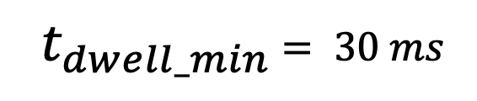


Algorithm: calculation example quad. drone
2. Input $ρ−t$ plane’s data: desired ${ N}_{min}, M, { N}_{migr_peak}$ (same formulas as prev.)
3. Start with ${ N}_{min}=1, M=1, { N}_{migr_peak}$ = 16 (considering the 4 rotors)
In this case we obtain:
${ t}_{dwell_min}$ $= 30 ms$
${ T}_{chirp_min}=0.265 ms$
${ T}_{chirp_max}=1.3 ms$
4. Fix ${ T}_{chirp}$ in order to maximize ${ N}_{min}, M \text{(}\text{same} \text{formulat}\text{s} \text{as} \text{prev}\text{.}\text{)}$
Now convergence is reached before only one cycle:
${ N}_{min}=2, M=2$
${ T}_{chirp_min}=0.53 ms$
${ T}_{chirp_max}=0.625 ms$
${ T}_{chirp_max}=20 ms$

Slide 14

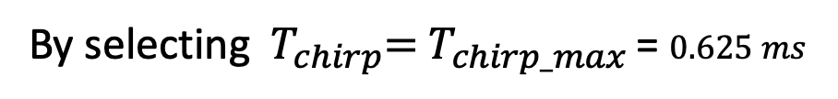
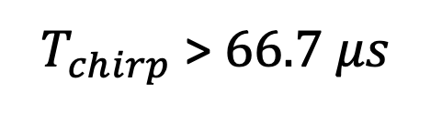
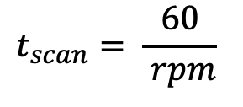

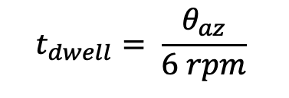
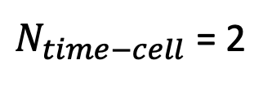
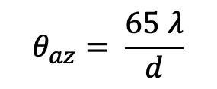



Algorithm: calculation example quad. drone
By selecting ${ T}_{chirp}={ T}_{chirp_max}$ = $0.625 ms$
$$N_{migr}=2$$
and
$N_{time−cell}$ = 2
5. Check if ${ T}_{chirp}$ satisfy unambiguous range condition:
${ T}_{chirp}$ > $66.7 μs$
6. Resulting $θ_{az}$, $d :$
$$t_{scan}= \frac{60}{ rpm}$$
$$rpm=30$$
$$t_{dwell}= \frac{θ_{az}}{6 rpm}$$
$$θ_{az}=t_{dwell_min} ∗6 rpm=5.4°$$
$$θ_{az}= \frac{65 λ}{d}$$
$$d=40 cm$$

Slide 15

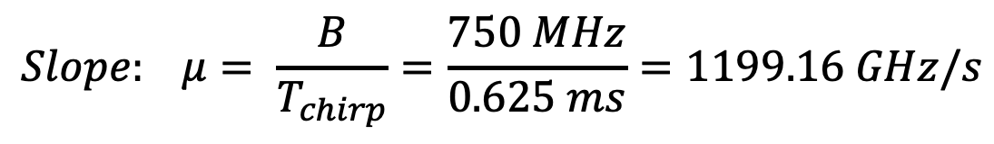
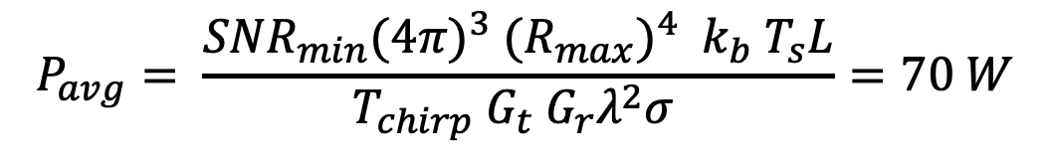
Algorithm: calculation example quad. drone
6. Resulting ${ P}_{avg}$ (same formulas as prev.):
$$P_{avg}= \frac{{SNR}_{min}{(4π)}^{3} {{(R}_{max})}^{4} { k}_{b} T_{s}L}{{{ T}_{chirp} G}_{t}{ G}_{r}λ^{2}σ }=70 W$$
G = 63.65
6. Resulting ${ f}_{ADC}, Slope$ :
$$Slope: μ= \frac{B}{T_{chirp}}=\frac{750 MHz}{0.625 ms}=1199.16 GHz/s$$
Graphic result in the next slide
$$f_{ADC}=2f_{IF_max} =16.0075 MHz$$

Slide 16
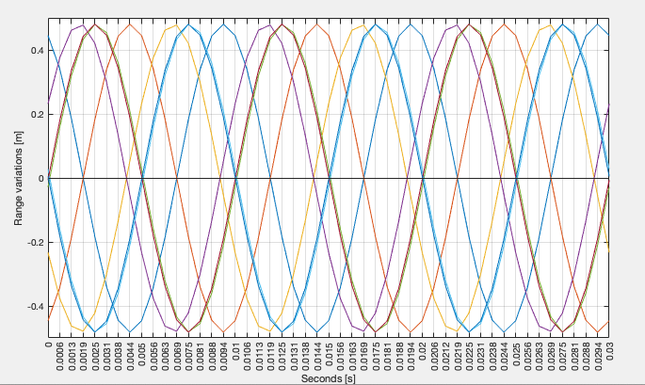





Algorithm: calculation example quad. drone
$$4 peak at period$$
$$∆r$$
${ N}_{migr}$ = 2
${ N}_{migr_peak}$ = 24
$$∆t={ T}_{chirp}$$

Slide 17
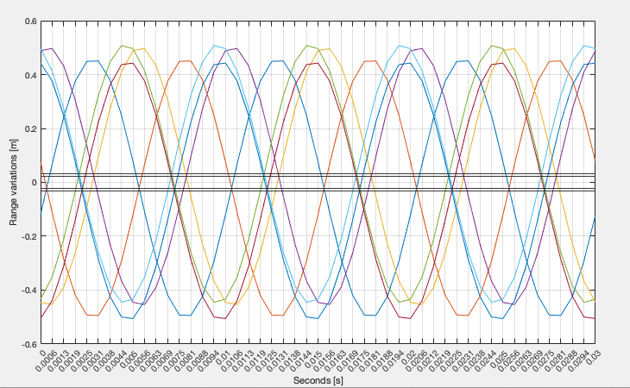
Algorithm: calculation example quad. drone
$$Taking into account the Different positions of each rotor$$

Slide 18
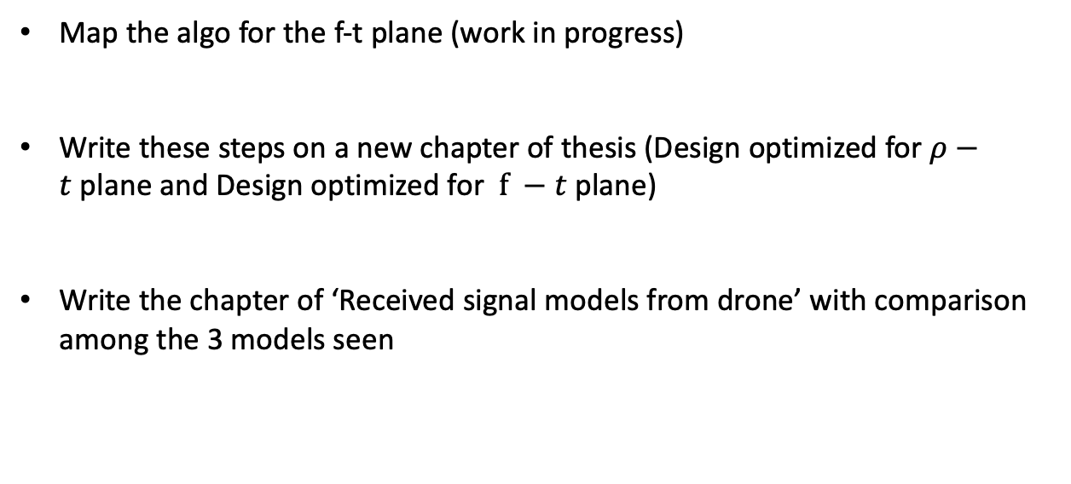
Next steps
Map the algo for the f-t plane (work in progress)
Write these steps on a new chapter of thesis (Design optimized for $ρ−t$plane and Design optimized for $f −t$plane)
Write the chapter of ‘Received signal models from drone’ with comparison among the 3 models seen
Thanks for attention!

